Slide 1
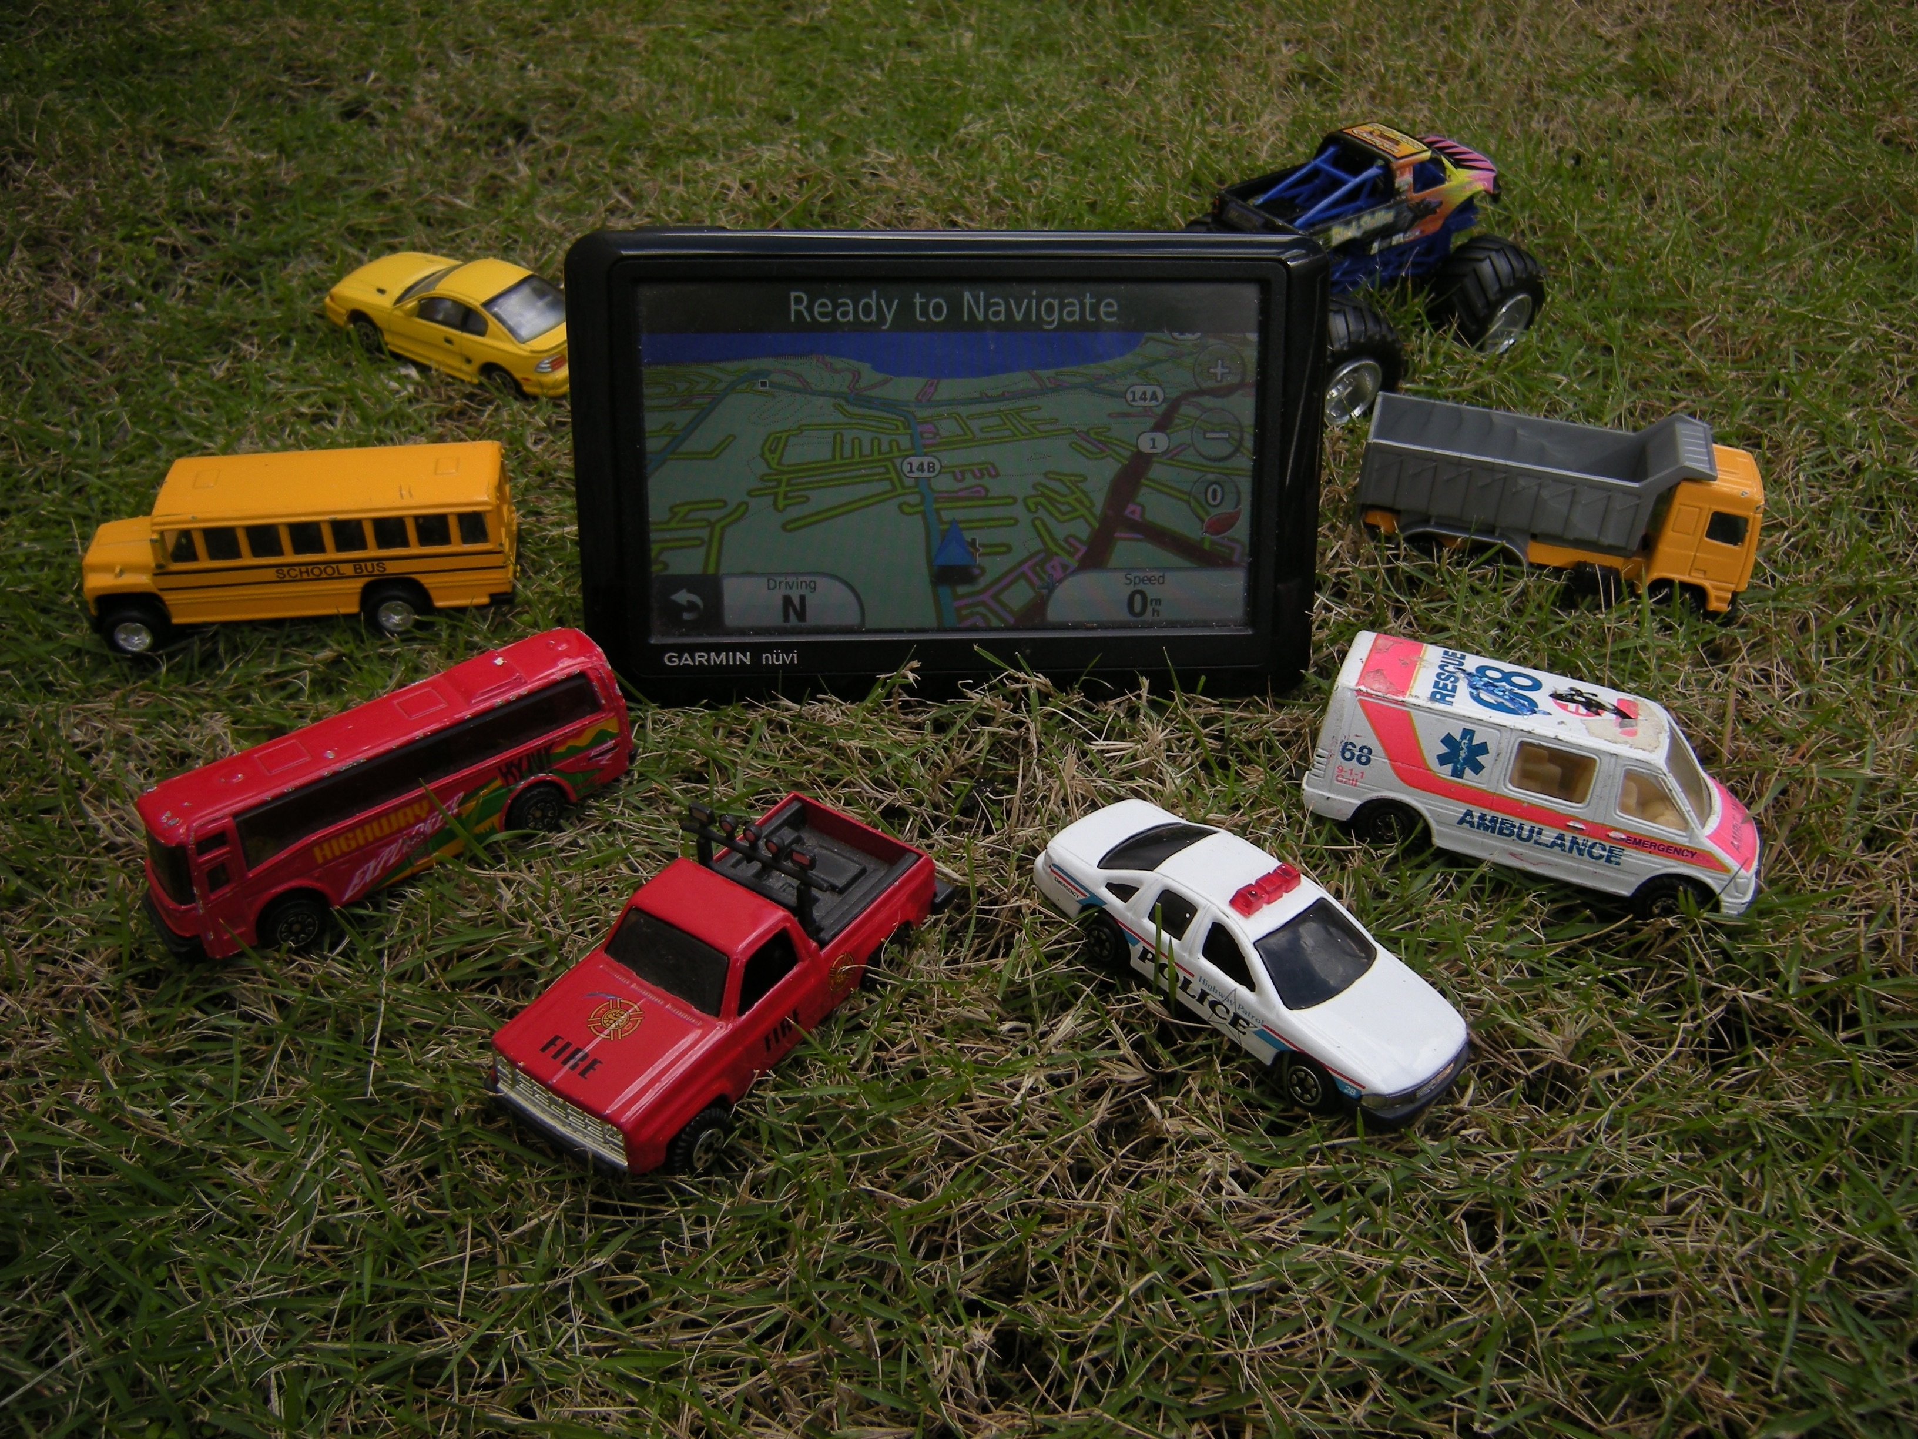
AUTO SALES DATA
RFM Analysis and Segmentation
VIDYA V
PGPDSBA.O.2023 B

Slide 2
Sample 1
AGENDA
Analyze the sales data to derive insights and identify patterns
Perform RFM Analysis and Segment Customers
Develop Specific Strategies for each segment

Slide 3

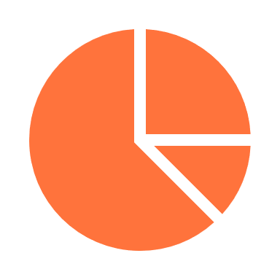






Sample 2
EXECUTIVE SUMMARY
2747
Orders
71
Cities
92.5%
Shipped Orders
7
Product Lines
89
Customers
19
Countries
96,428
Total quantity
$9.76 M
Total Sales

Slide 4

UNIVARIATE ANALYSIS

Slide 5
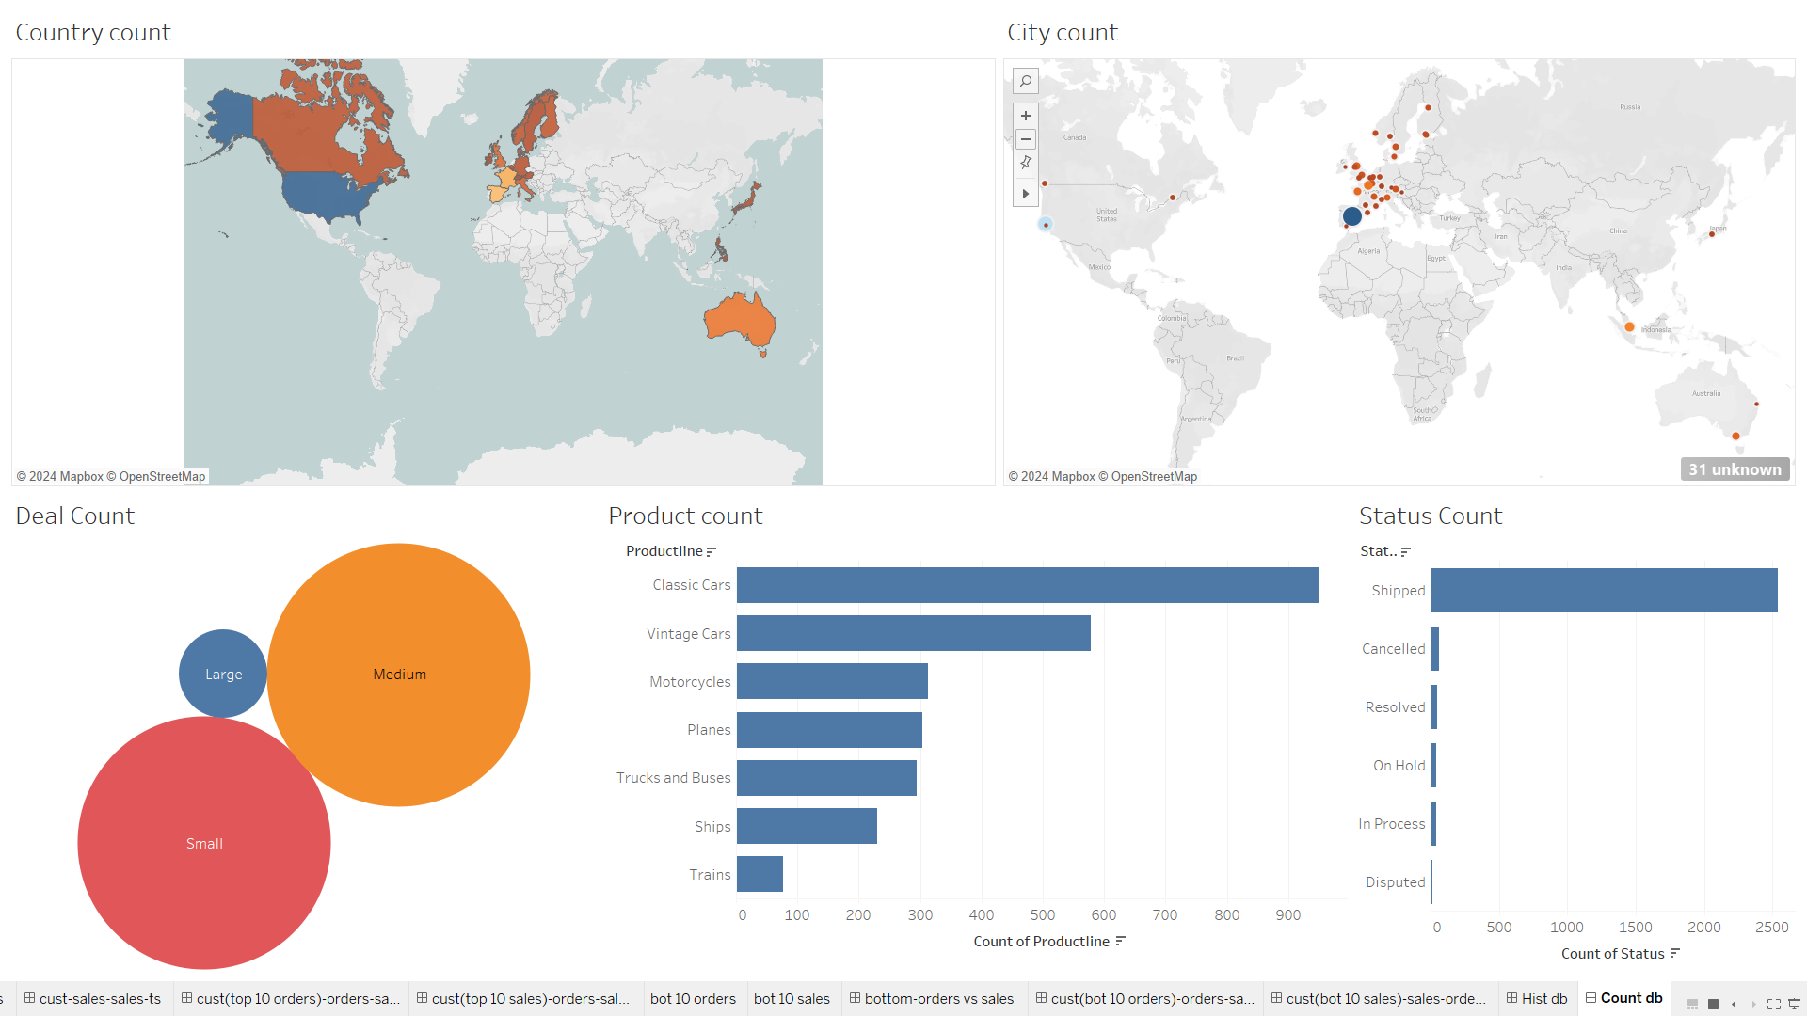
Sample 3

Slide 6
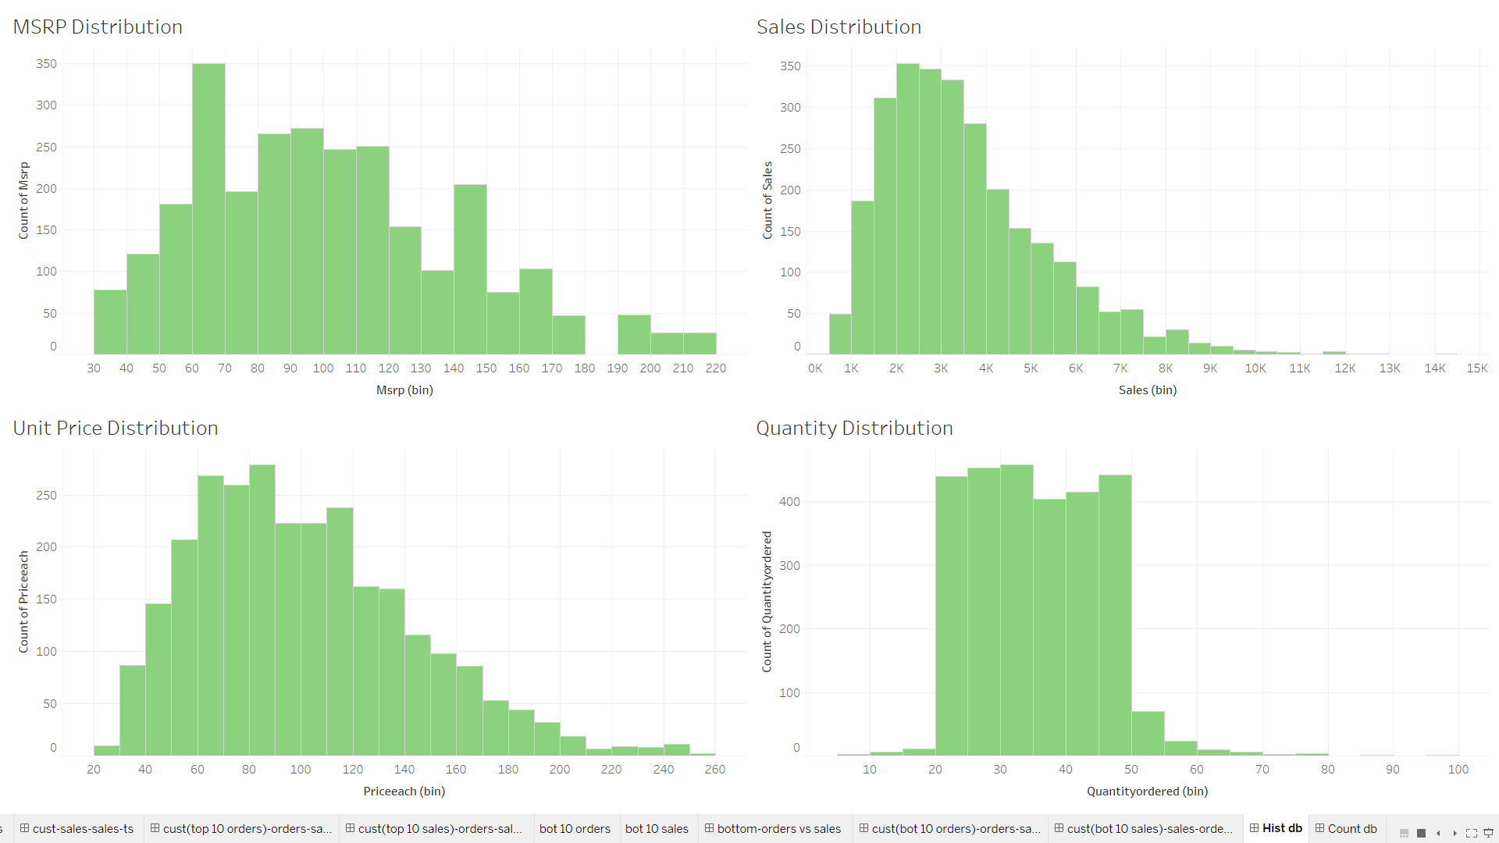

Slide 7
BIVARIATE ANALYSIS

Slide 8
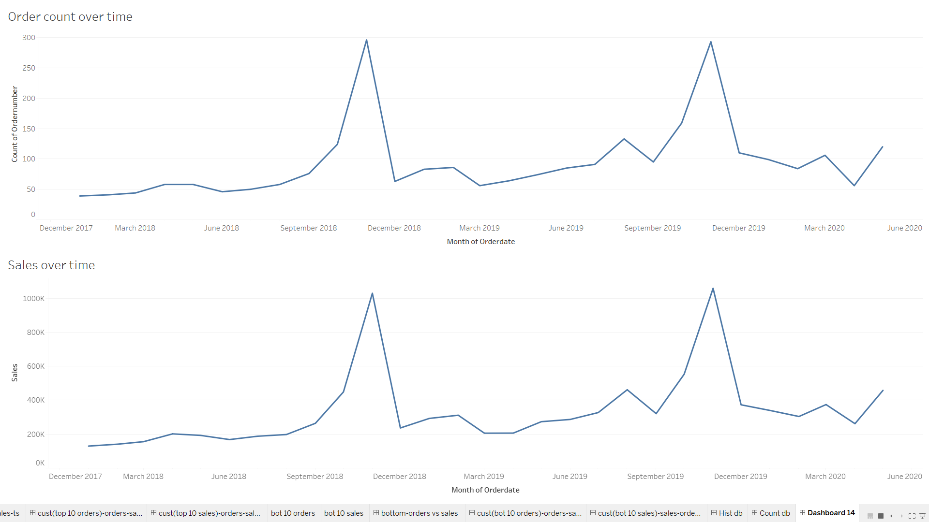

Slide 9
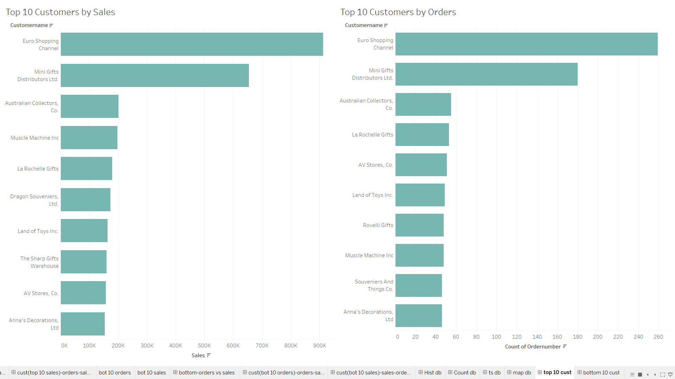

Slide 10
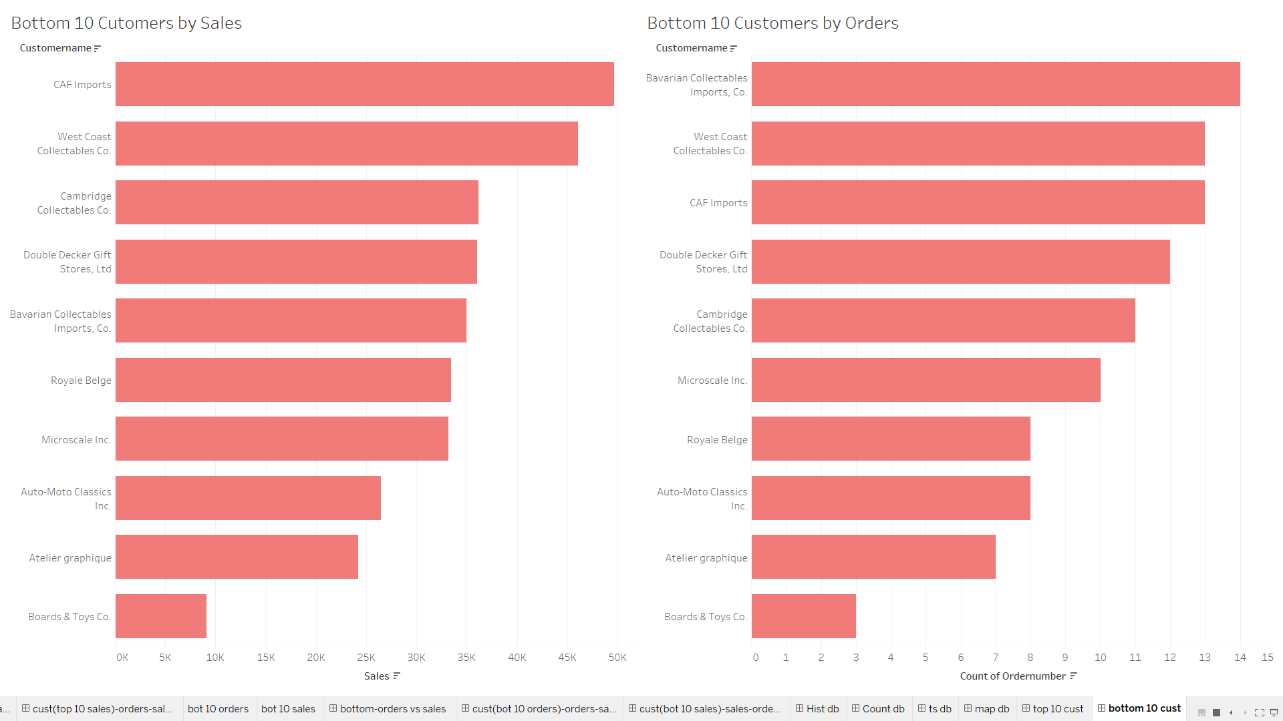

Slide 11
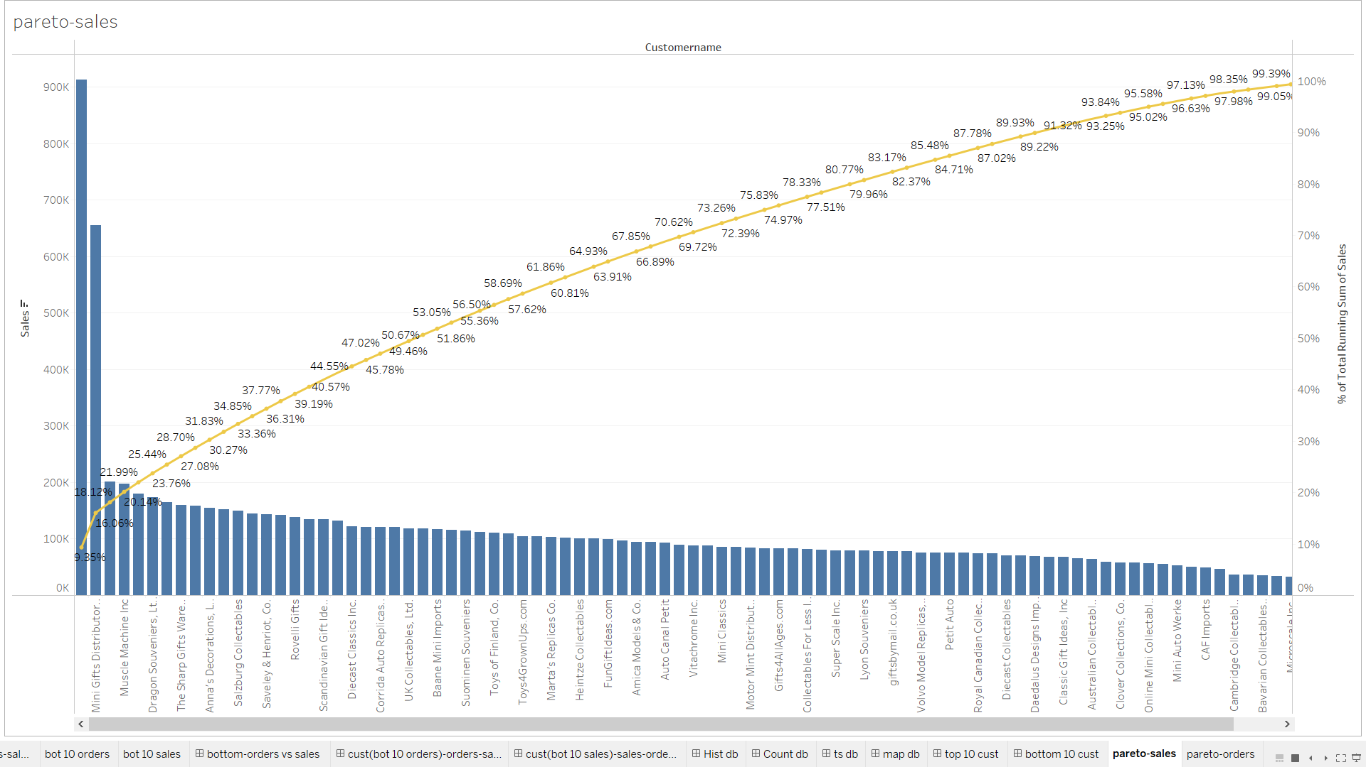

Slide 12
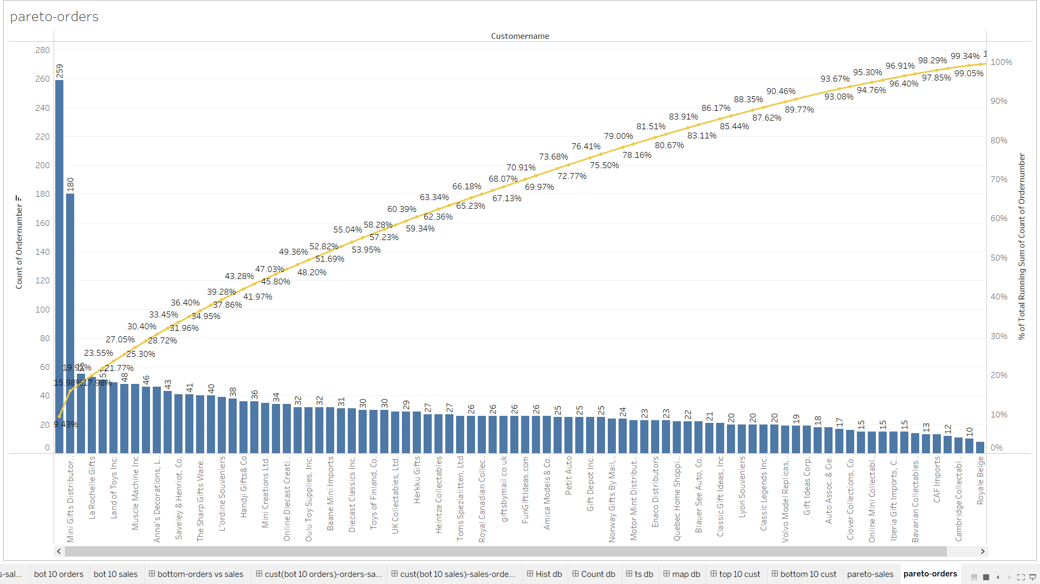

Slide 13
MULTIVARIATE ANALYSIS

Slide 14
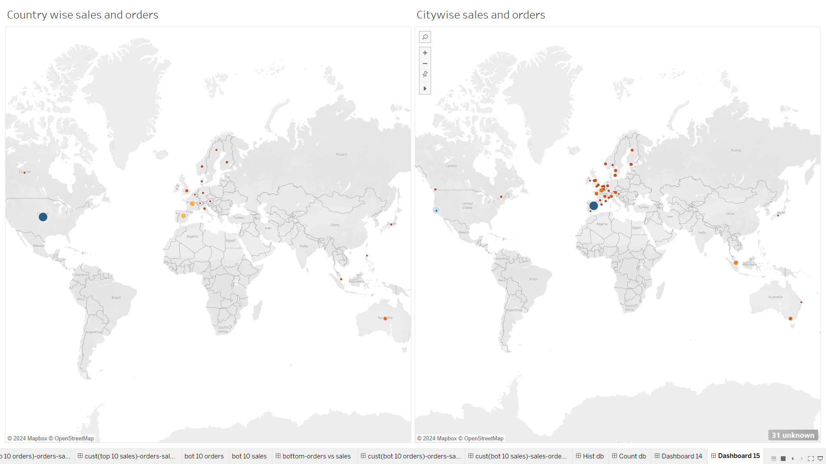
USA is the country with the highest sales and number of orders
USA is the country with the highest sales and number of orders
Spain is the city with the highest sales and number of orders
Spain is the city with the highest sales and number of orders

Slide 15
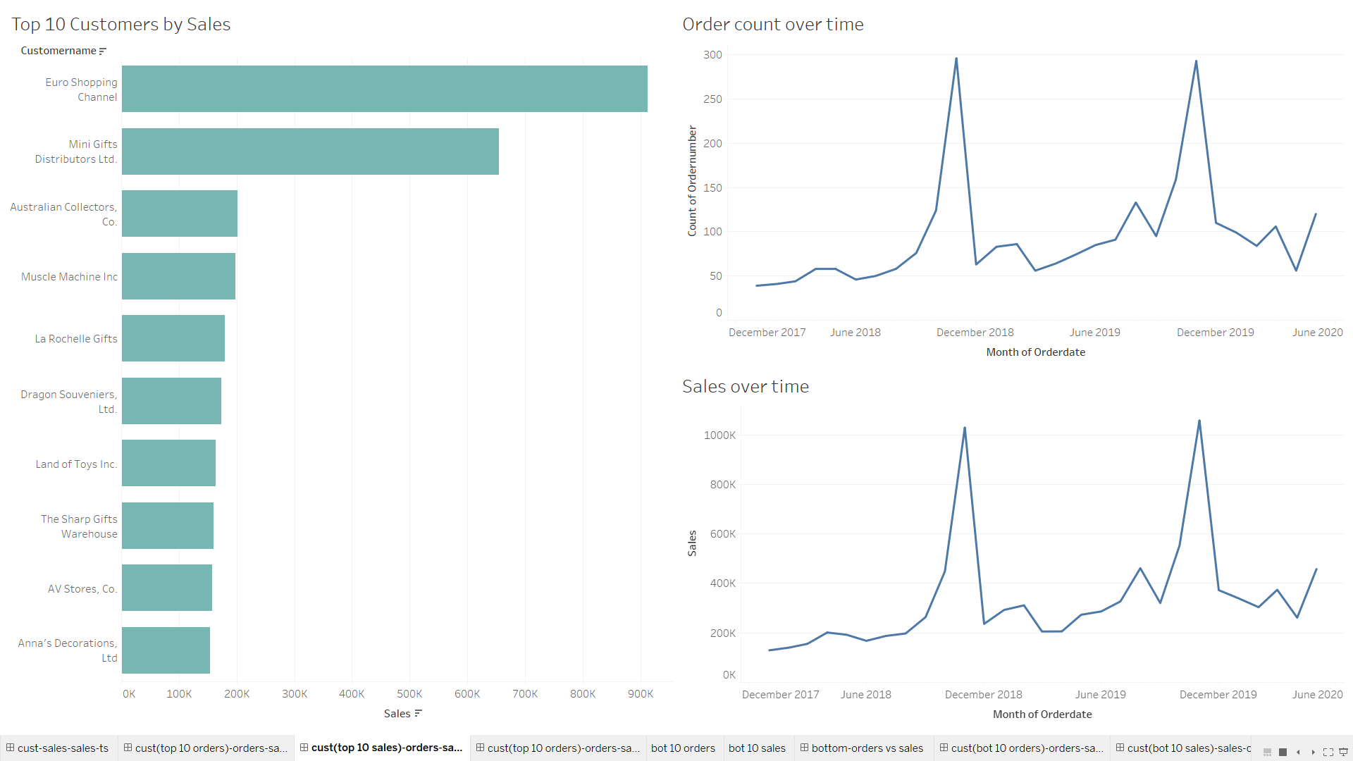

Slide 16
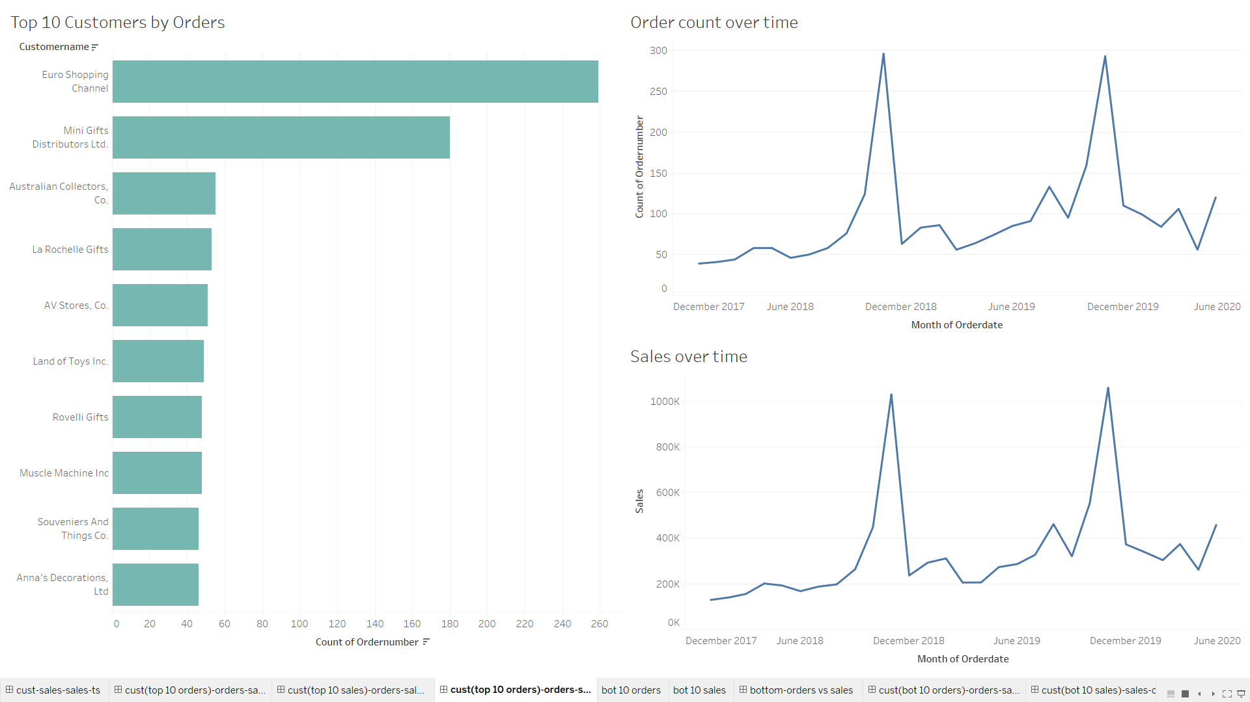

Slide 17
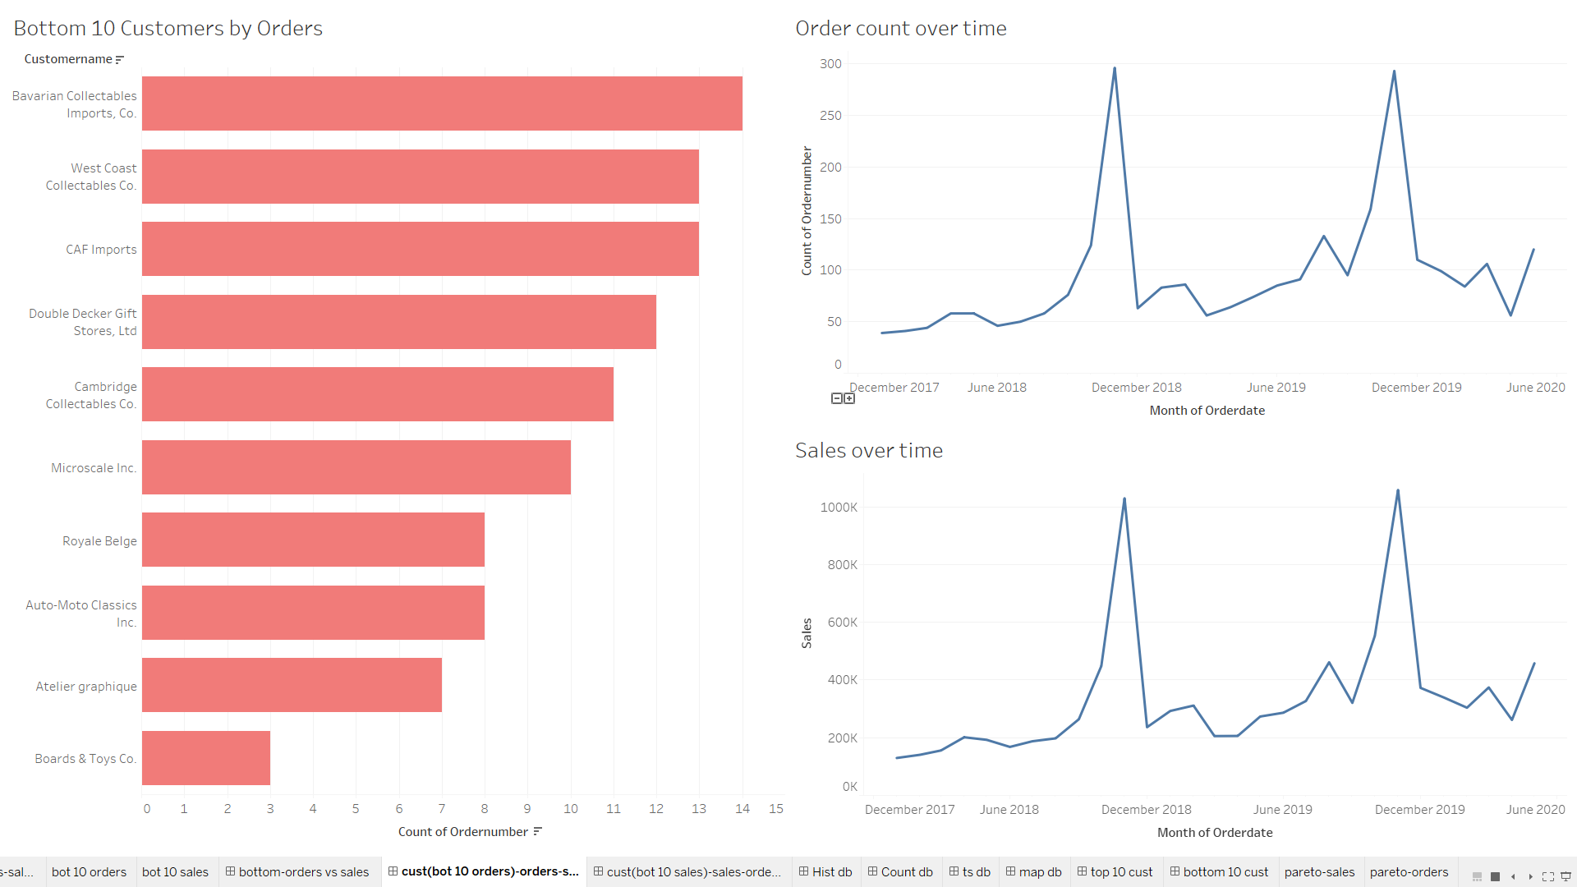

Slide 18
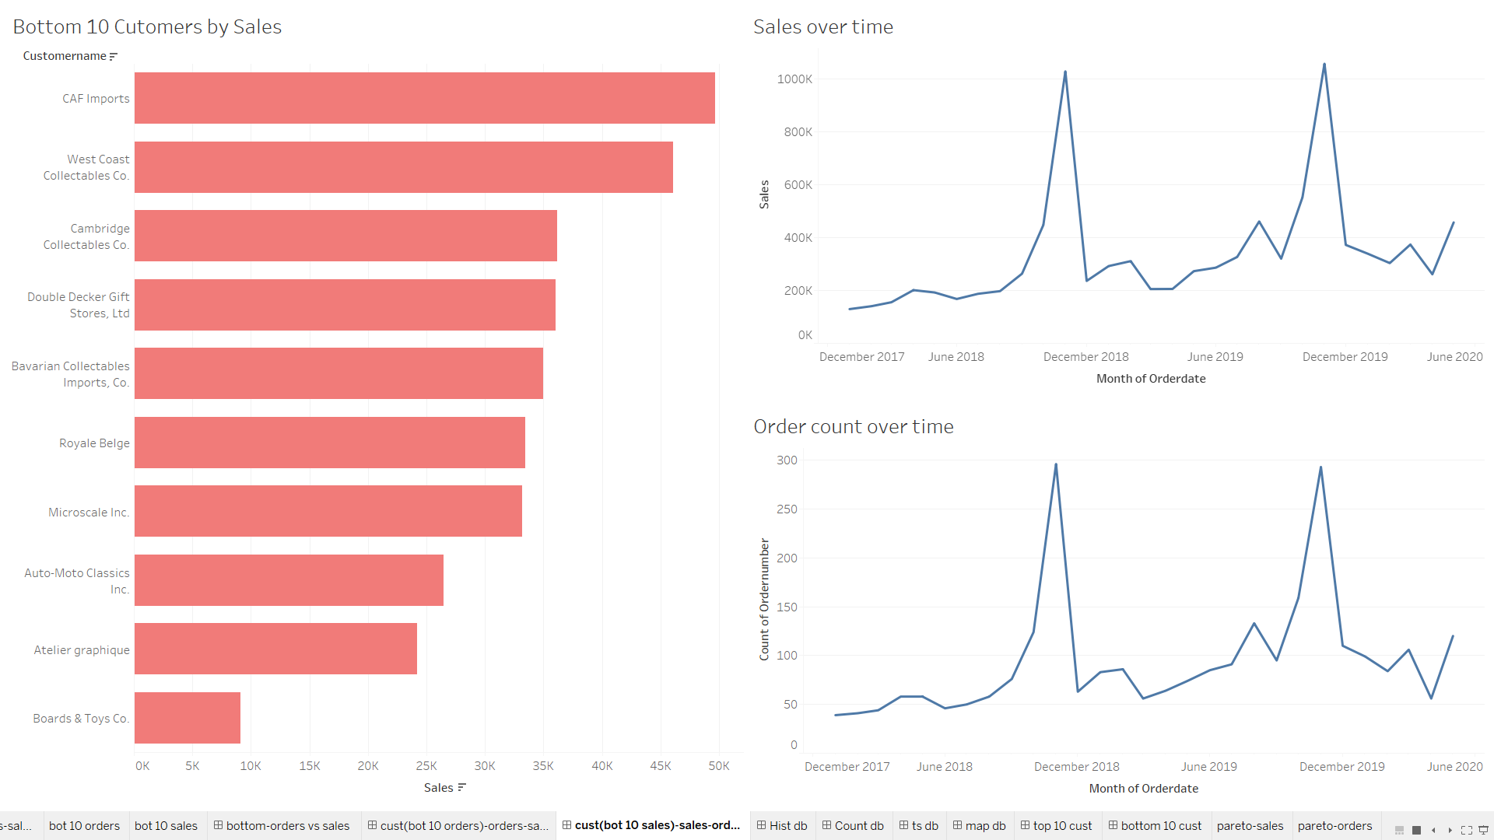

Slide 19
EDA OBSERVATIONS
USA is the country where most of the orders come from and is also the country with the highest sales
Madrid is the city with most number of orders and highest sales
There is no observable trend in the number of orders or the sales over the given period of 29 months
Euro Shopping Channel, Mini Gifts Distributors Ltd are two best customers with the highest number of orders and highest total sales
The top 10 customers contribute to approximately 30% of total orders and total sales

Slide 20
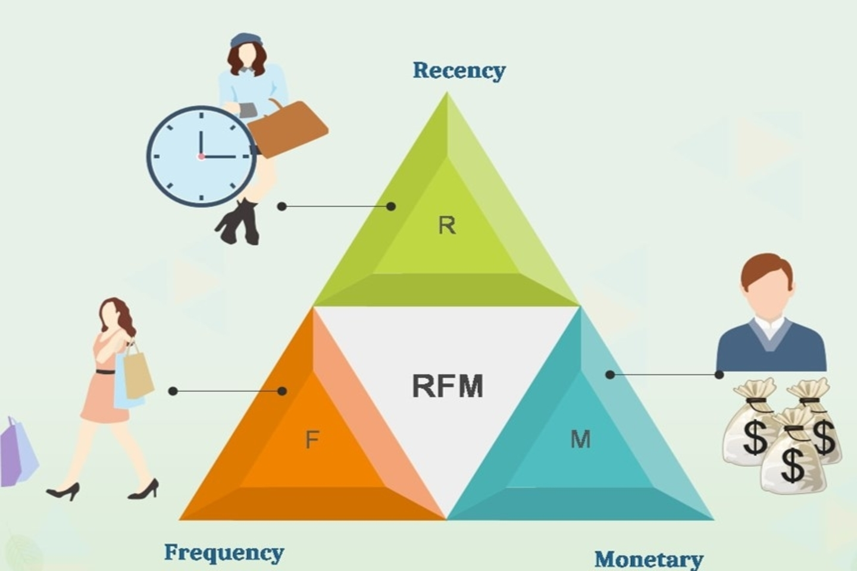
RFM ANALYSIS

Slide 21
RFM ANALYSIS
Technique used to identify three metrics- Recency, Frequency and Monetary values of each customer using their transactions
Objective: Customer Segmentation and development of specific marketing strategies to the target segments
Recency: Measure of how recently the purchase was made. Helps determine the engagement and responsiveness of customers
Frequency: Measure of how frequent the purchases are. Helps determine the loyalty of customers
Monetary: Measure of the sales bought in by the customers. Helps determine the monetary value of customers

Slide 22
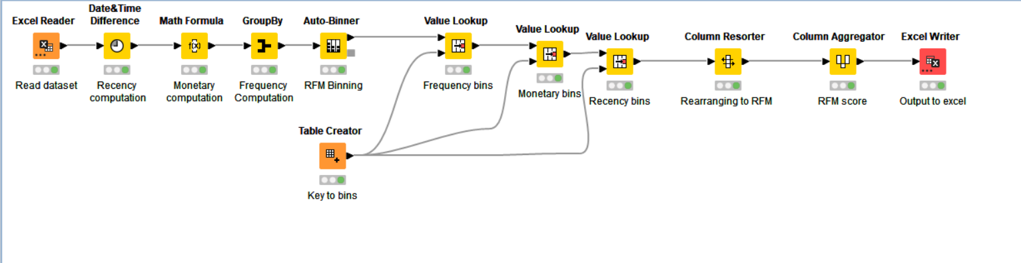
KNIME WORKFLOW

Slide 23
METHOD OF DETERMINING RFM
Recency:
Determine the date difference of each transaction from a reference date- 01-07-2020
Find the minimum date difference after grouping by customer name
Frequency:
Group by customer name and count the number of orders.
This is the total number of orders by the customer in 29 months
Monetary:
Group by customer name and compute the sum of sales for all the orders
This is the total sales for the company from the customer

Slide 24
SEGMENTATION AFTER RFM
After computing the RFM metrics, a scoring system was developed using the auto binner node
Each customer was assigned a bin for recency, frequency and monetary columns
The key for the assignment of bins for frequency and monetary columns is as follows:
Bin 1- 0-25th percentile of column values
Bin 2- 25th -50th percentile of column values
Bin 3- 50th-75th percentile of column values
Bin 4- 75-100th percentile of column values
The key for the assignment of bins for recency column is as follows:
Bin 4- 0-25th percentile of column values
Bin 3- 25th -50th percentile of column values
Bin 2- 50th-75th percentile of column values
Bin 1- 75-100th percentile of column values

Slide 25
SEGMENTATION AFTER RFM
That is for all these columns, the worst values would be given the lowest bin and the nest values would be assigned the highest bin
After this, an RFM score column was computed by concatenating the bins assigned
This score had values 111,112,113,114,121,122,123,124,…..444
Based on these scores, the customers were segmented into four categories:
Best Customers- RFM scores => [444]
Loyal Customers- RFM scores => [144,244,343,344,443,444]
Customers on the verge of churning- RFM scores =>[112,122,123,133,144]
Lost Customers- RFM scores =>[111]
That is,
Best customers are those who have ordered recently, frequently and have contributed highly to the sales volume

Slide 26
SEGMENTATION AFTER RFM
That is,
Best customers are those who have ordered recently, frequently and have contributed highly to the sales volume
Loyal customers have high frequency of orders, even if it does not have a high monetary score
Customers who have the lowest recency score are on the verge of churning, even if they have high frequency and monetary scores
Lost customers have the highest days since last order, have a low frequency and monetary scores

Slide 27
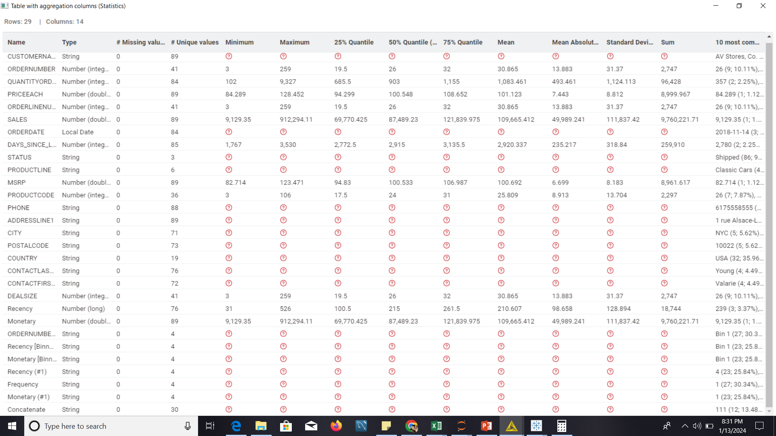

Slide 28

BEST CUSTOMERS

Slide 29
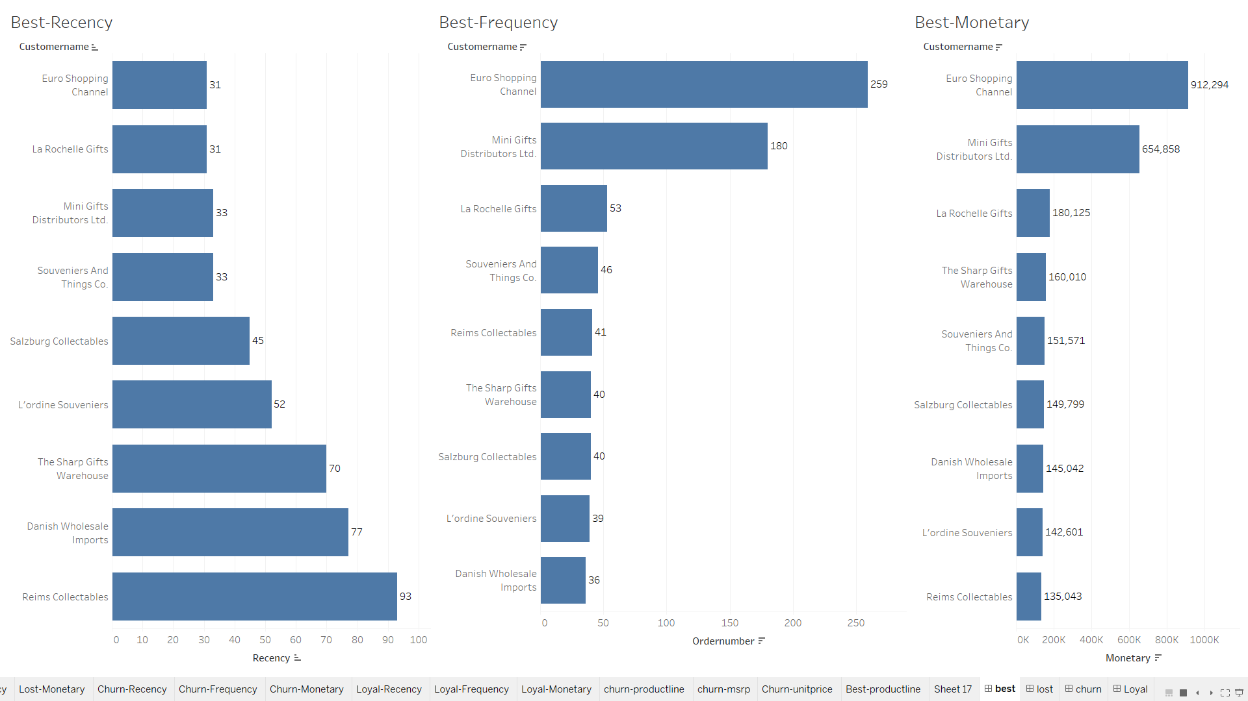

Slide 30
INSIGHTS & RECOMMENDATIONS
To retain these, any amount of offers could be given, some of which include:
Lowering of MSRP
Offering Big Deals
Expediting shipments

Slide 31

LOYAL CUSTOMERS

Slide 32
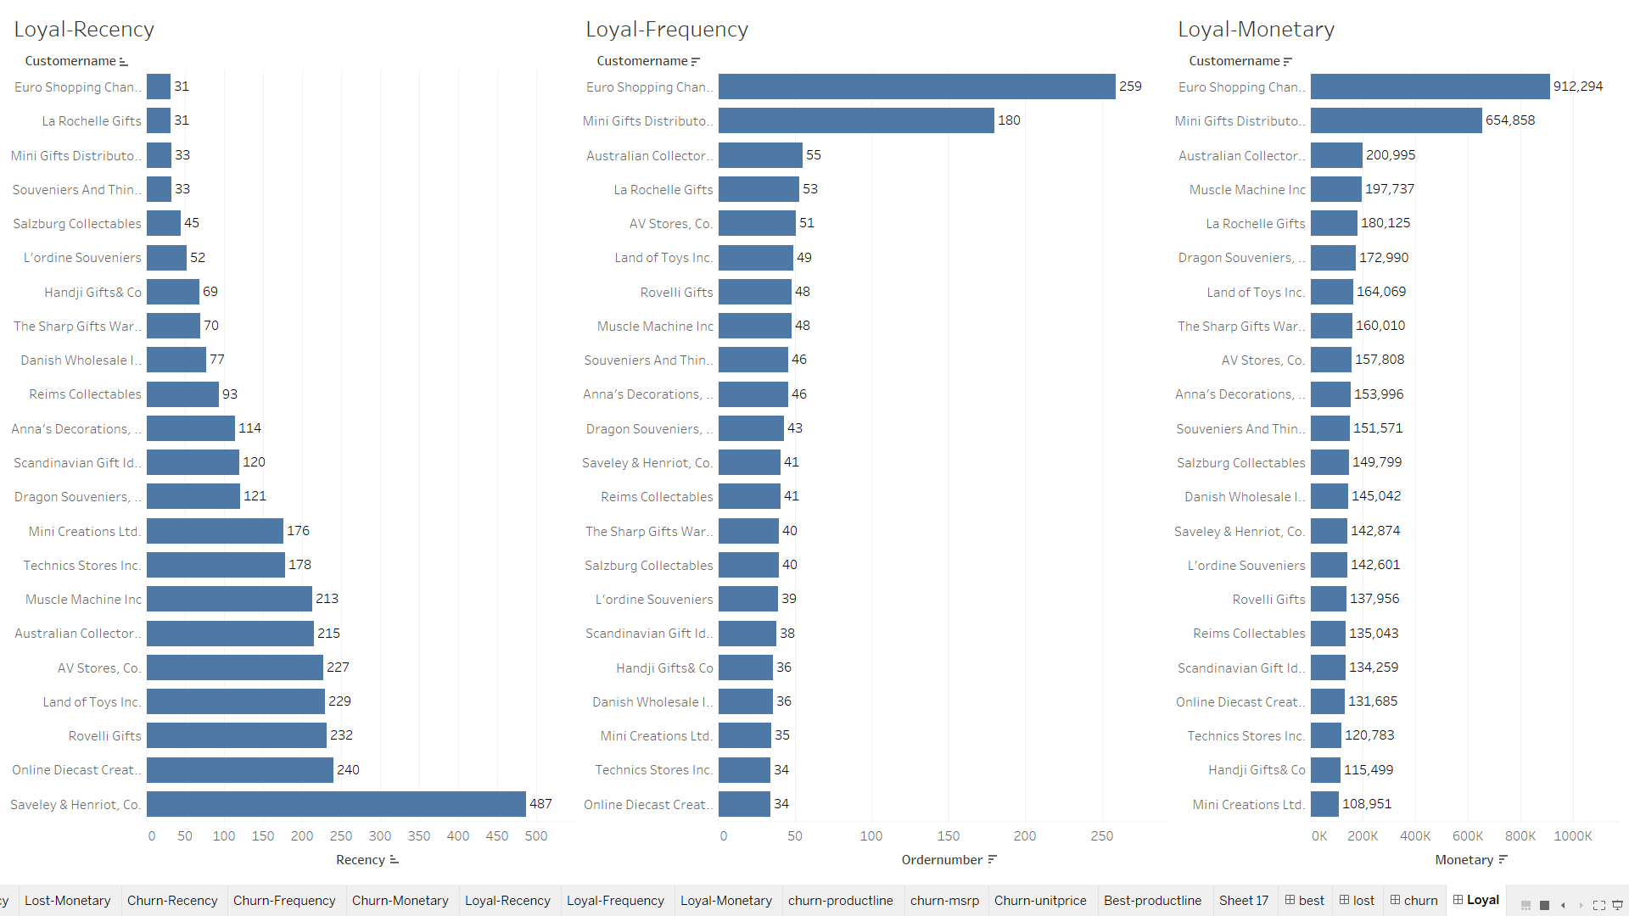

Slide 33
INSIGHTS & RECOMMENDATIONS
Though these customers have a high frequency, their monetary contributions need to improve.
This could be achieved by :
Offering better deals
Upselling product lines with higher MSRP
Offering package deals to encourage buying more quantity
Care should be taken to improve the recency of purchase for those customers, whose recency is low

Slide 34
CUSTOMERS ABOUT TO CHURN

Slide 35
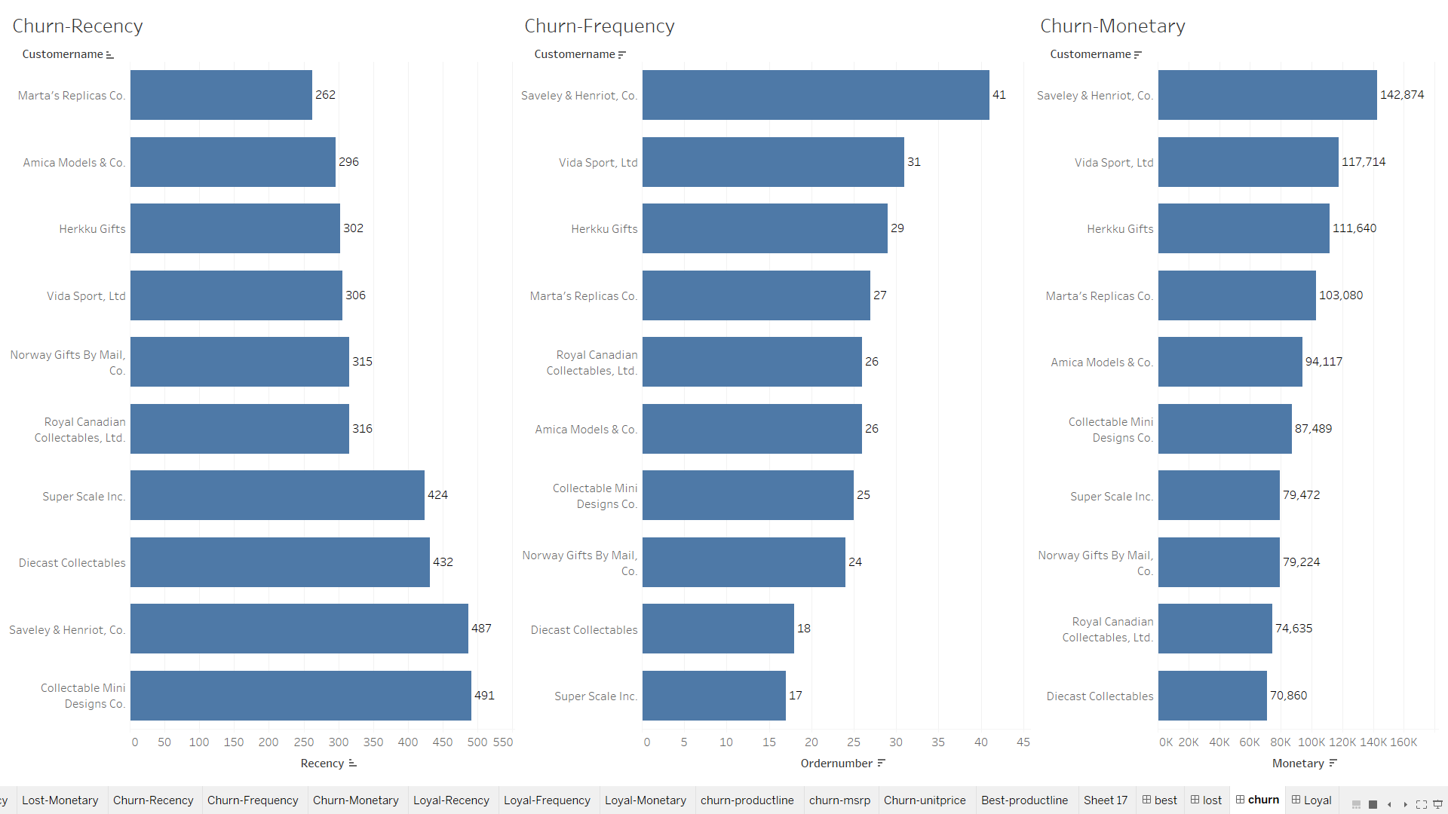

Slide 36
INSIGHTS & RECOMMENDATIONS
The reasons for the increase in the gap of purchase of these customers need to be investigated
If no action is taken, these customers could churn, leading to a loss of about $35k per year
Particular care should be taken in the case of Saveley Henriot & Co, which also falls under the loyal customer category, and also have a good Monetary score
Efforts to be taken to contact the customer and determine the reason for gap in purchases
If it is something at the company’s end, it has to be immediately addressed

Slide 37
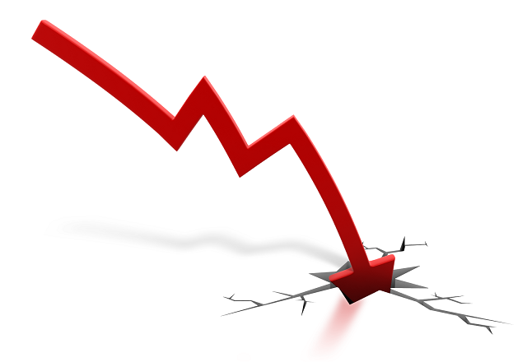
LOST CUSTOMERS

Slide 38
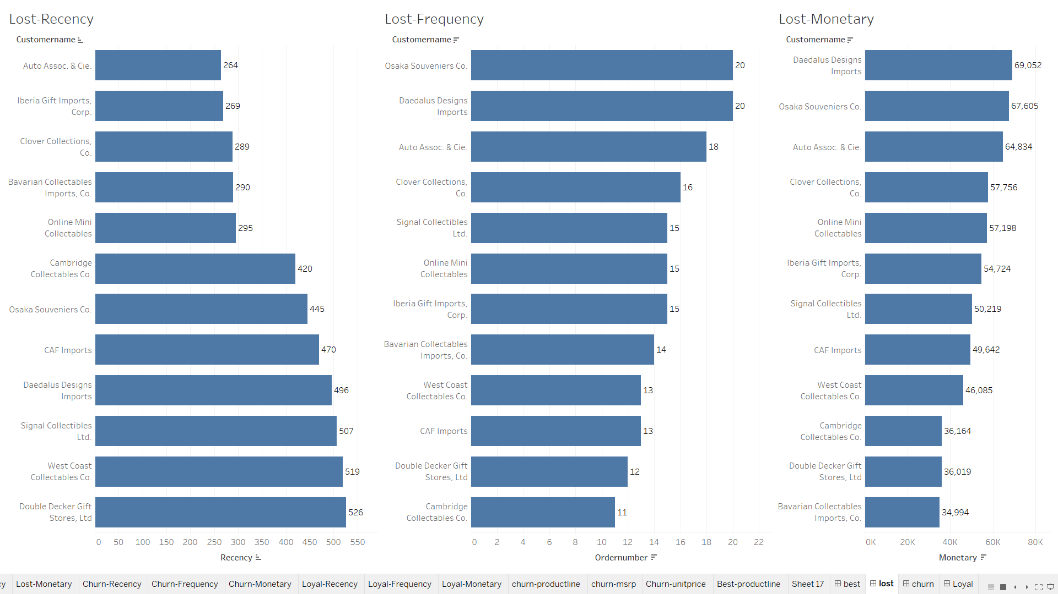

Slide 39
INSIGHTS & RECOMMENDATIONS
Lost customers might prove hard to earn back
A practical actionable deed could be to investigate the cause of the loss and improve the bottlenecks so that no more customers face the need to leave the company

Slide 40
THANK YOU

